Slide 1
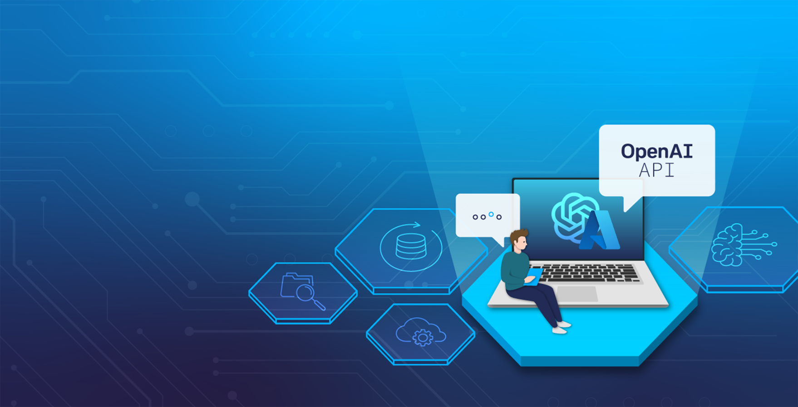
Introduction
A Hands-on Exploration of the Azure OpenAI API
30.05.2024

Slide 2
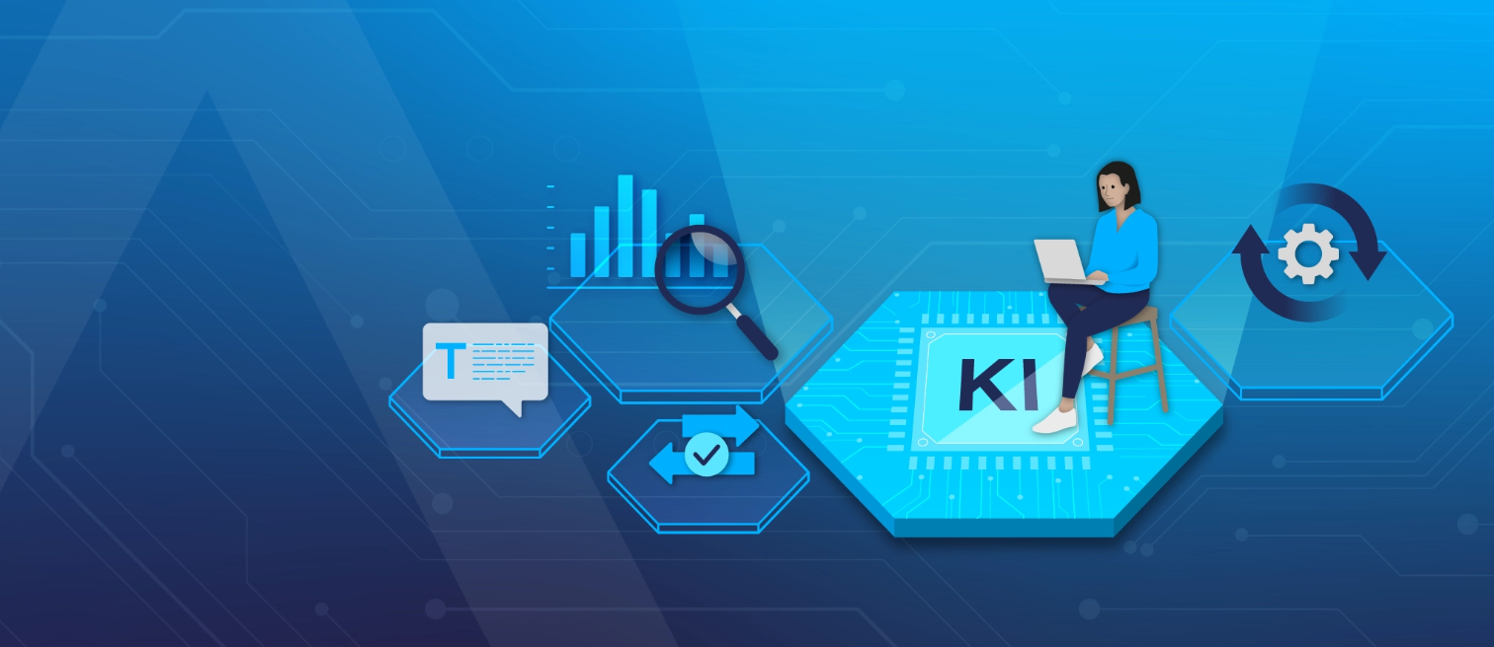
13:30 – 14:00
Workshop Introduction (Part 1)
Workshop Preparations (Part 2)
Using the Azure OpenAI API (Part 3)
15:00 – 15:30
Coffee Break
15:30 – 16:45
Retrieval-Augmented Generation (Part 4)
Fine-Tuning (Part 5)
Image-To-Text using GPT4o (Part 6)
16:45 – 17:00
Extras | Q&A

Slide 3
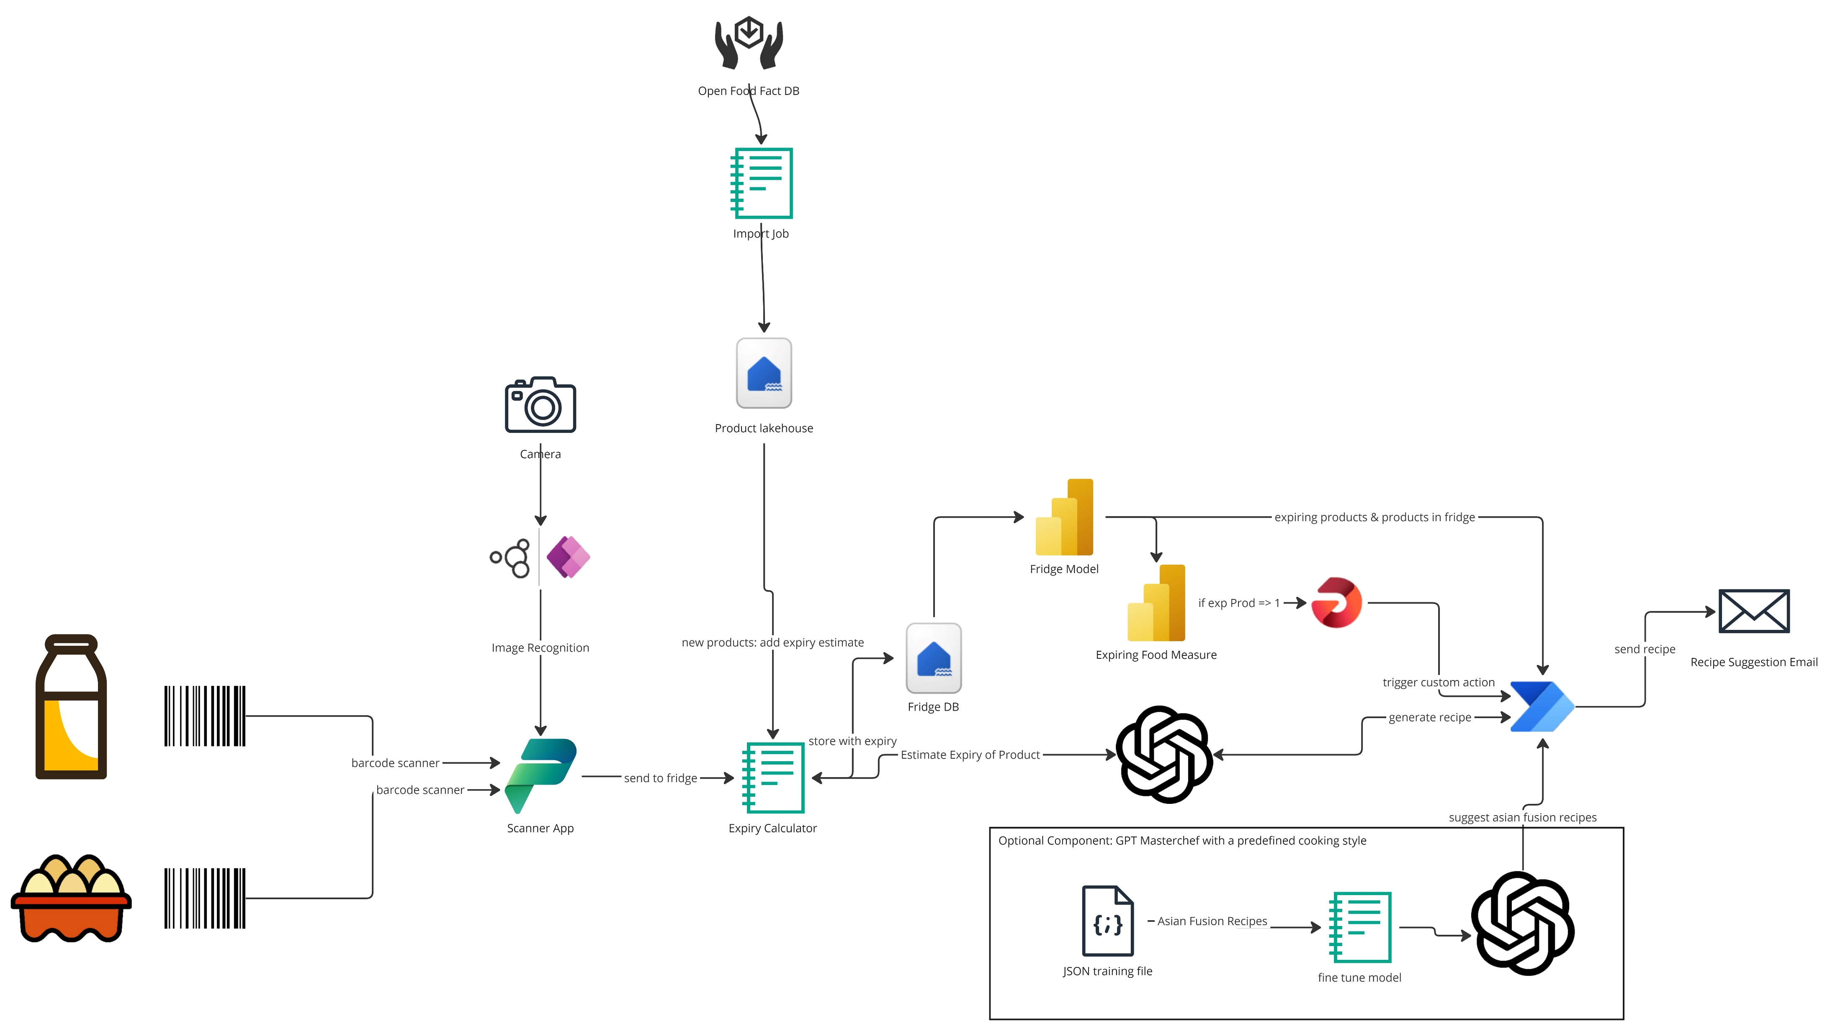
Workshop Use Case

Slide 4
Objectives
Create recipes from a list of ingredients.
Improve created recipes using enhancement techniques: prompt engineering with zero-shot, one-shot, and few-shot learning.
Improve created recipes using Retrieval Augmented Generation (RAG).
Improve created recipes using Fine-Tuning.
Showcase data pre-processing Azure OpenAI Assistant API.
Showcase GPT-4o model, translating images into text.

Slide 5

Azure OpenAI Service
Access to various large language models (LLMs), including GPT-4, GPT-4 Turbo with Vision, GPT-3.5-Turbo, and Embeddings model series. These are the same language models made available by OpenAI.
Azure OpenAI Service powers the next generation of startups | Microsoft for Startups Blog

Slide 6

Large Language Models Used
GPT-4o
GPT-4
GPT-3.5-Turbo
Embeddings

Slide 7
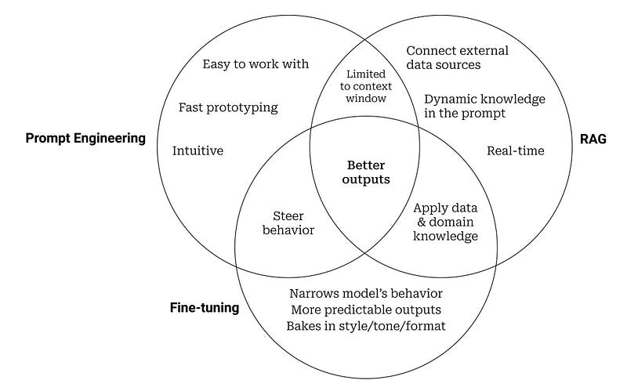
Enhancement Techniques
Approaches to AI: When to Use Prompt Engineering, Embeddings, or Fine-tuning | Entry Point AI

Slide 8
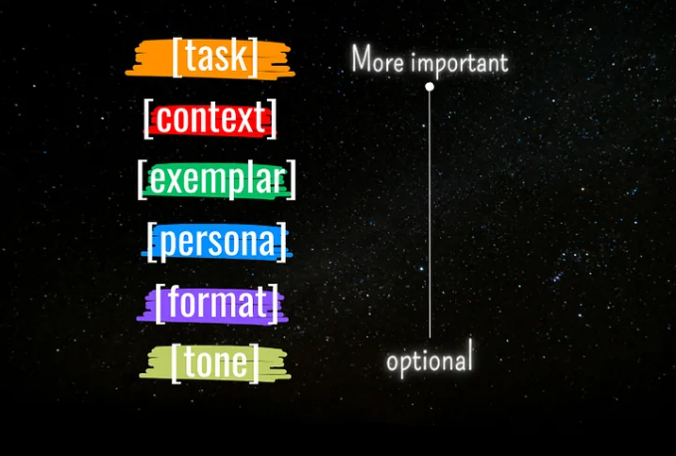
Prompt Engineering
Master the Perfect ChatGPT Prompt Formula | by DatHero | Medium

Slide 9
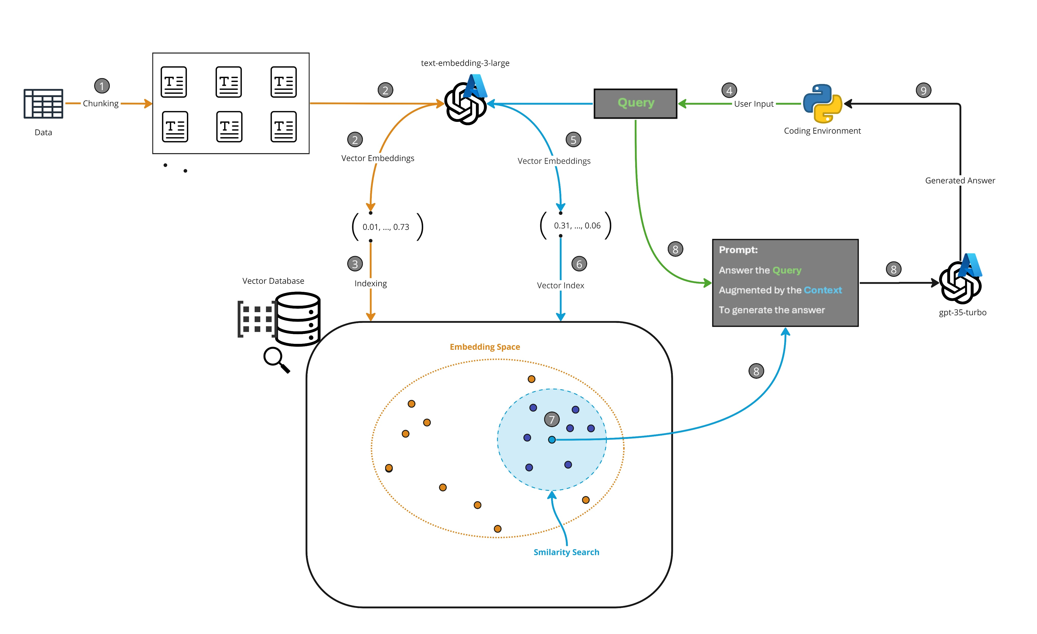
Retrieval Augmented Generation

Slide 10
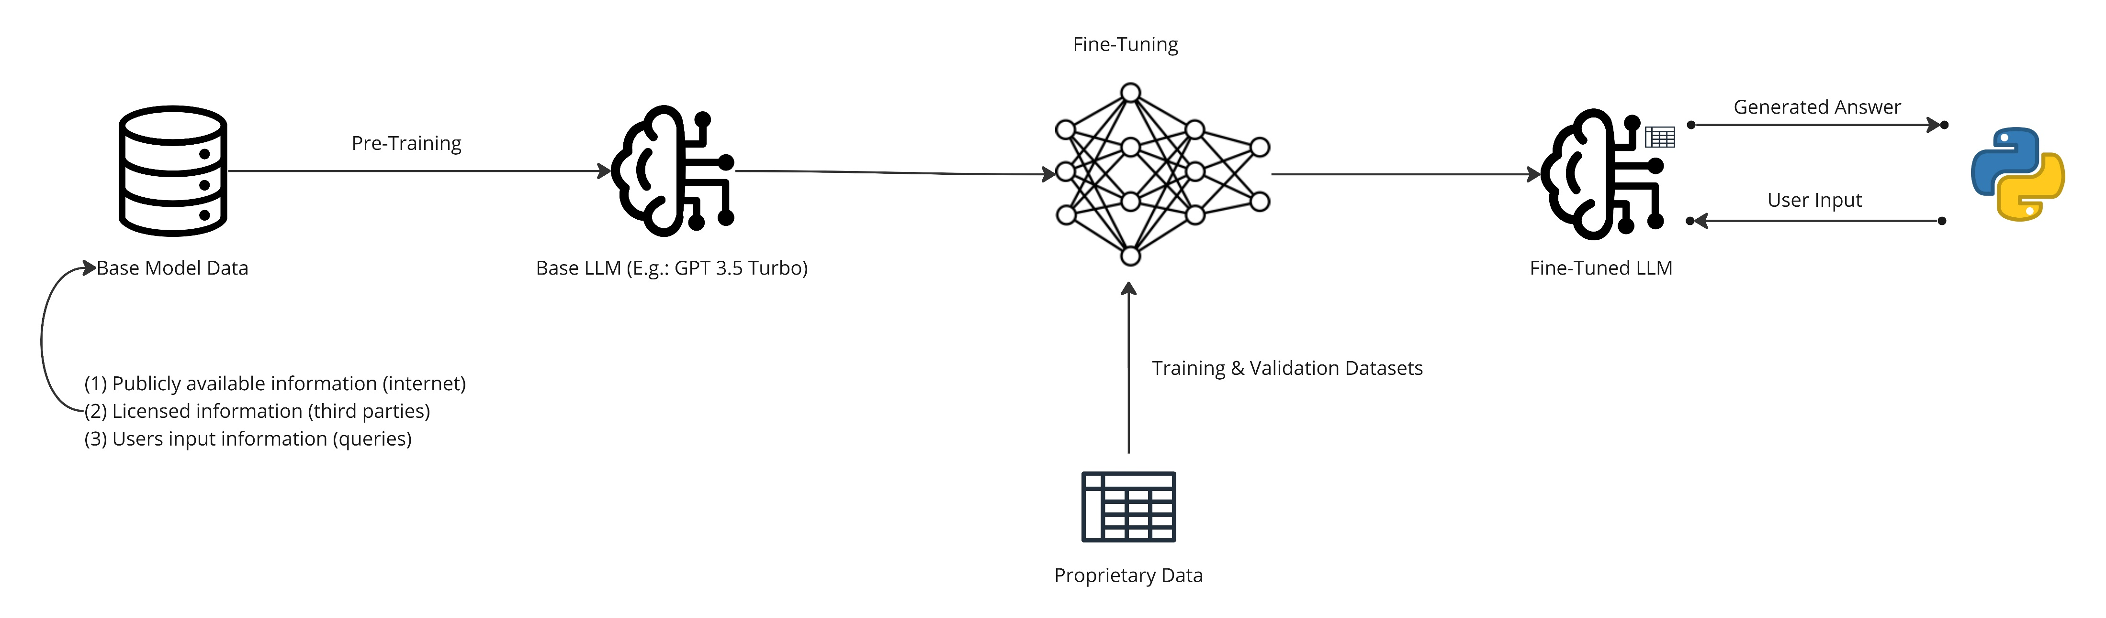
Fine-Tuning

Slide 11
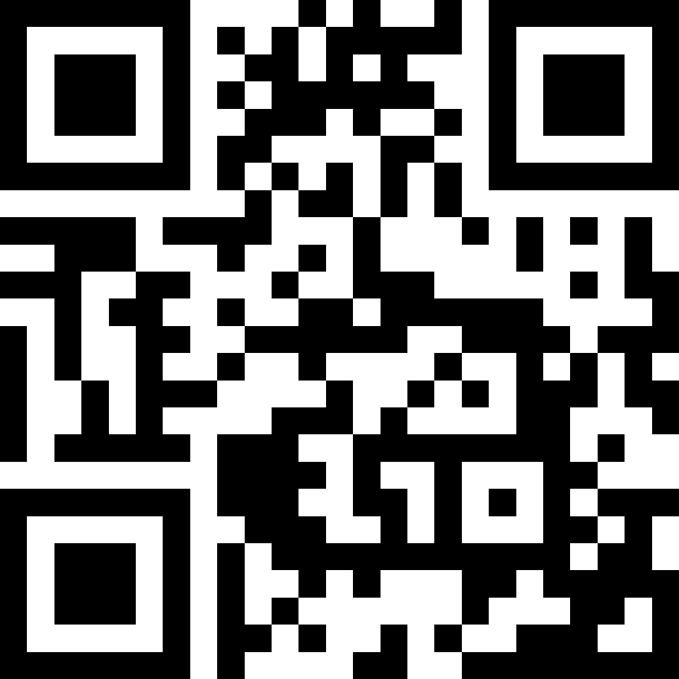
https://tinyurl.com/aoiworkshop
Scan the QR code and open the git repository on your PC
QR Code Generator (the-qrcode-generator.com)

Slide 12
Extras | Q&A

Slide 13
Questions?

Slide 14
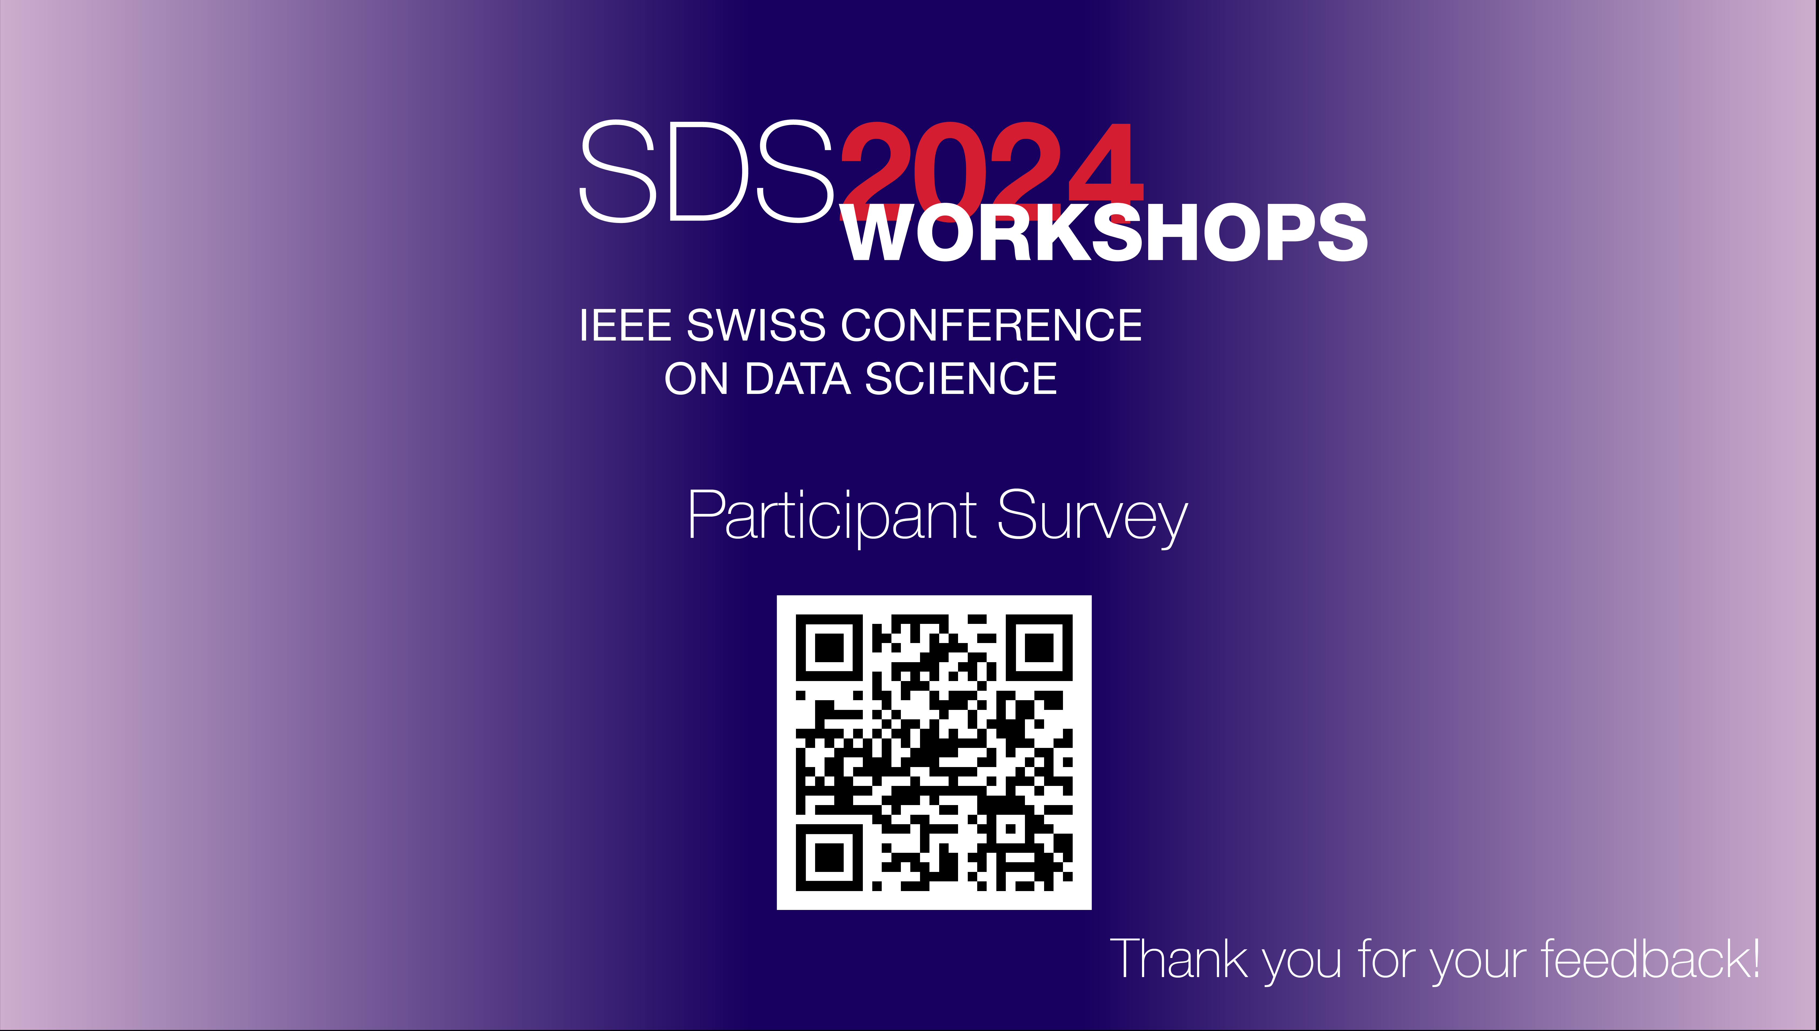
Survey

